Slide 1
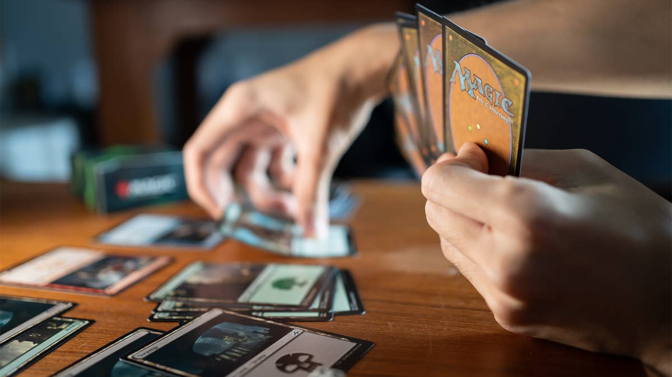
Improving game Development: Magic the gathering
Bryan D’Amico
Notes:
Magic The Gathering is a leader in the gaming industry earning over one billion dollars each year, and today we’re going to be looking at how machine learning and text mining could be used to help the game development process for this worldwide phenomenon.

Slide 2
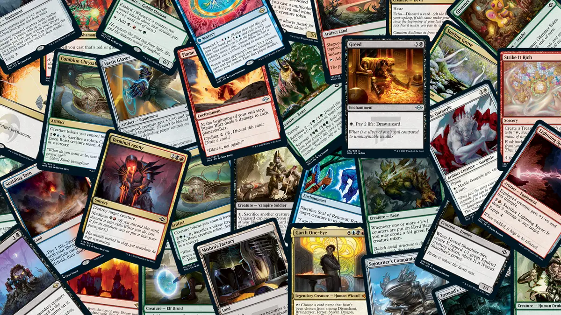
Agenda
Introduction
Goals
Models and Methods
Conclusions and Next Steps
Notes:
First, we’ll start with some background on Magic and the state of the game today, followed by the goals of the analysis. Then we’ll look at the results of that analysis before discussing the important takeaways and potential next steps.

Slide 3
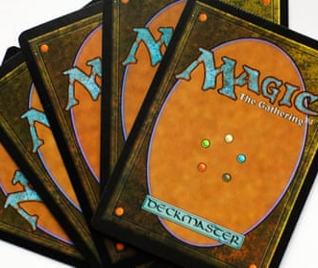
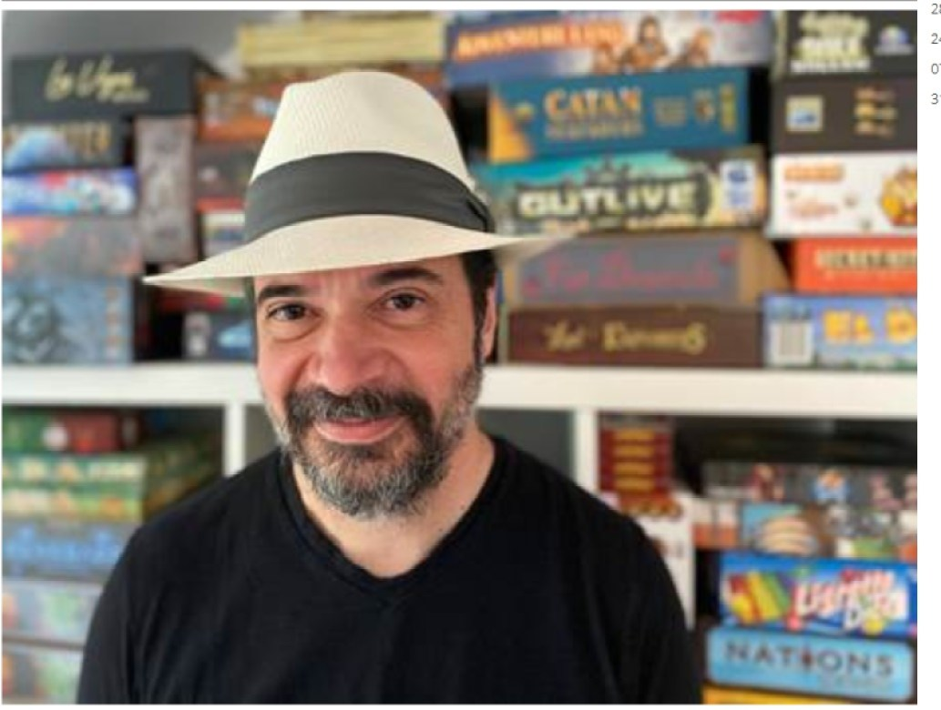
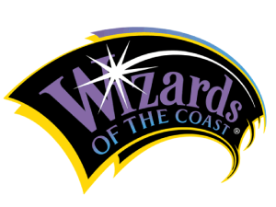
History of mtg
Richard Garfield
Wizards of the Coast
Origins Game Fair, 1993
Five Magics Game Concept
Notes:
Magic the Gathering was created by Richard Garfield when he was tasked with creating a fun game that people could play at conventions by Peter Adkison, the owner of the up and coming gaming company Wizards of the Coast. The game was based on an idea that Garfield had for a long time where five different types of magical powers were used. He created the concept of players acting as wizards and using cards to cast spells or summon creatures that would fight against one another. The game went through several iterations during a two year development period before debuting at the Origins Game Fair in 1993.
Magic involves each player constructing a deck from cards they have collected that are centered around one or more colors of mana, or magic power. Those colors, red, blue, black, green, and white allow each player to play only certain types of cards with certain abilities. No one color will have access to all the abilities present in the game. Players usually start with 20 life points each and battle one another until someone runs out of life points. This game was an immediate smash hit and the first printing of 2.5 million cards sold out right away.

Slide 4
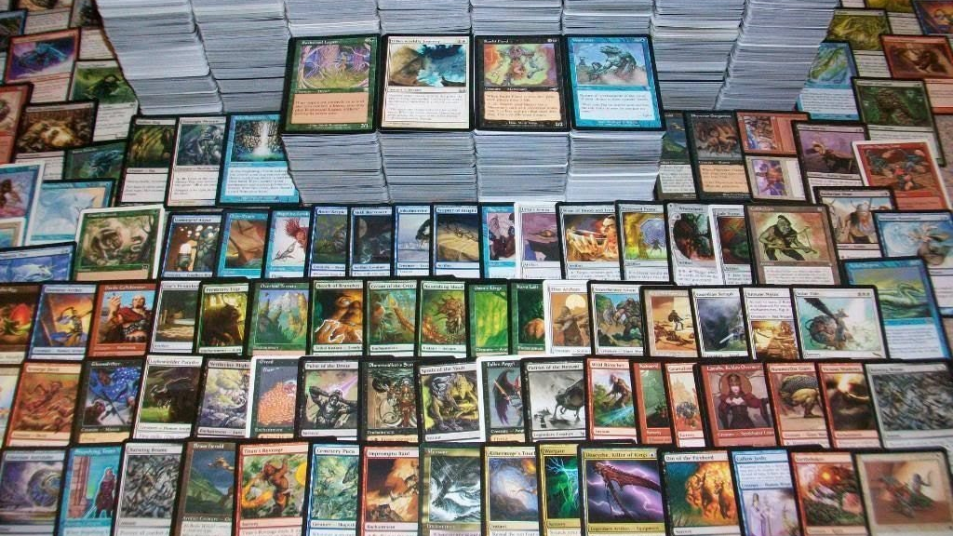
MTG Today
Ever-evolving set of rules
Played worldwide
30 years of history
How to keep MTG fresh and exciting?
Notes:
Over the last 30 years Magic has continued to evolve to keep players interested, and most importantly for Wizards of the Coast, buying more cards. There are now many different rule sets, formats where only certain releases of cards can played, and cards that can alter the entire gameplay of a match. Its continuous growth since its inception has seen it become a world wide phenomenon. It is the most played trading card game in the world and features professional tournament levels of play. These tournaments often feature 1 million or more dollars in prizes and are a huge opportunity for Wizards of the Coast to draw an even larger audience. All this success brings along with it a lot of pressure however. The game developers must continue to find new ways to keep Magic exciting by printing cards that do really cool things while not making players feel like their old cards are obsolete or that the game has changed to become radically different than what players know it to be.

Slide 5
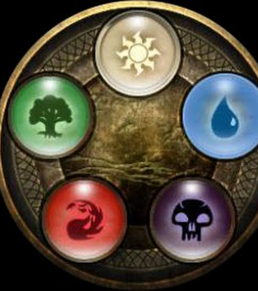
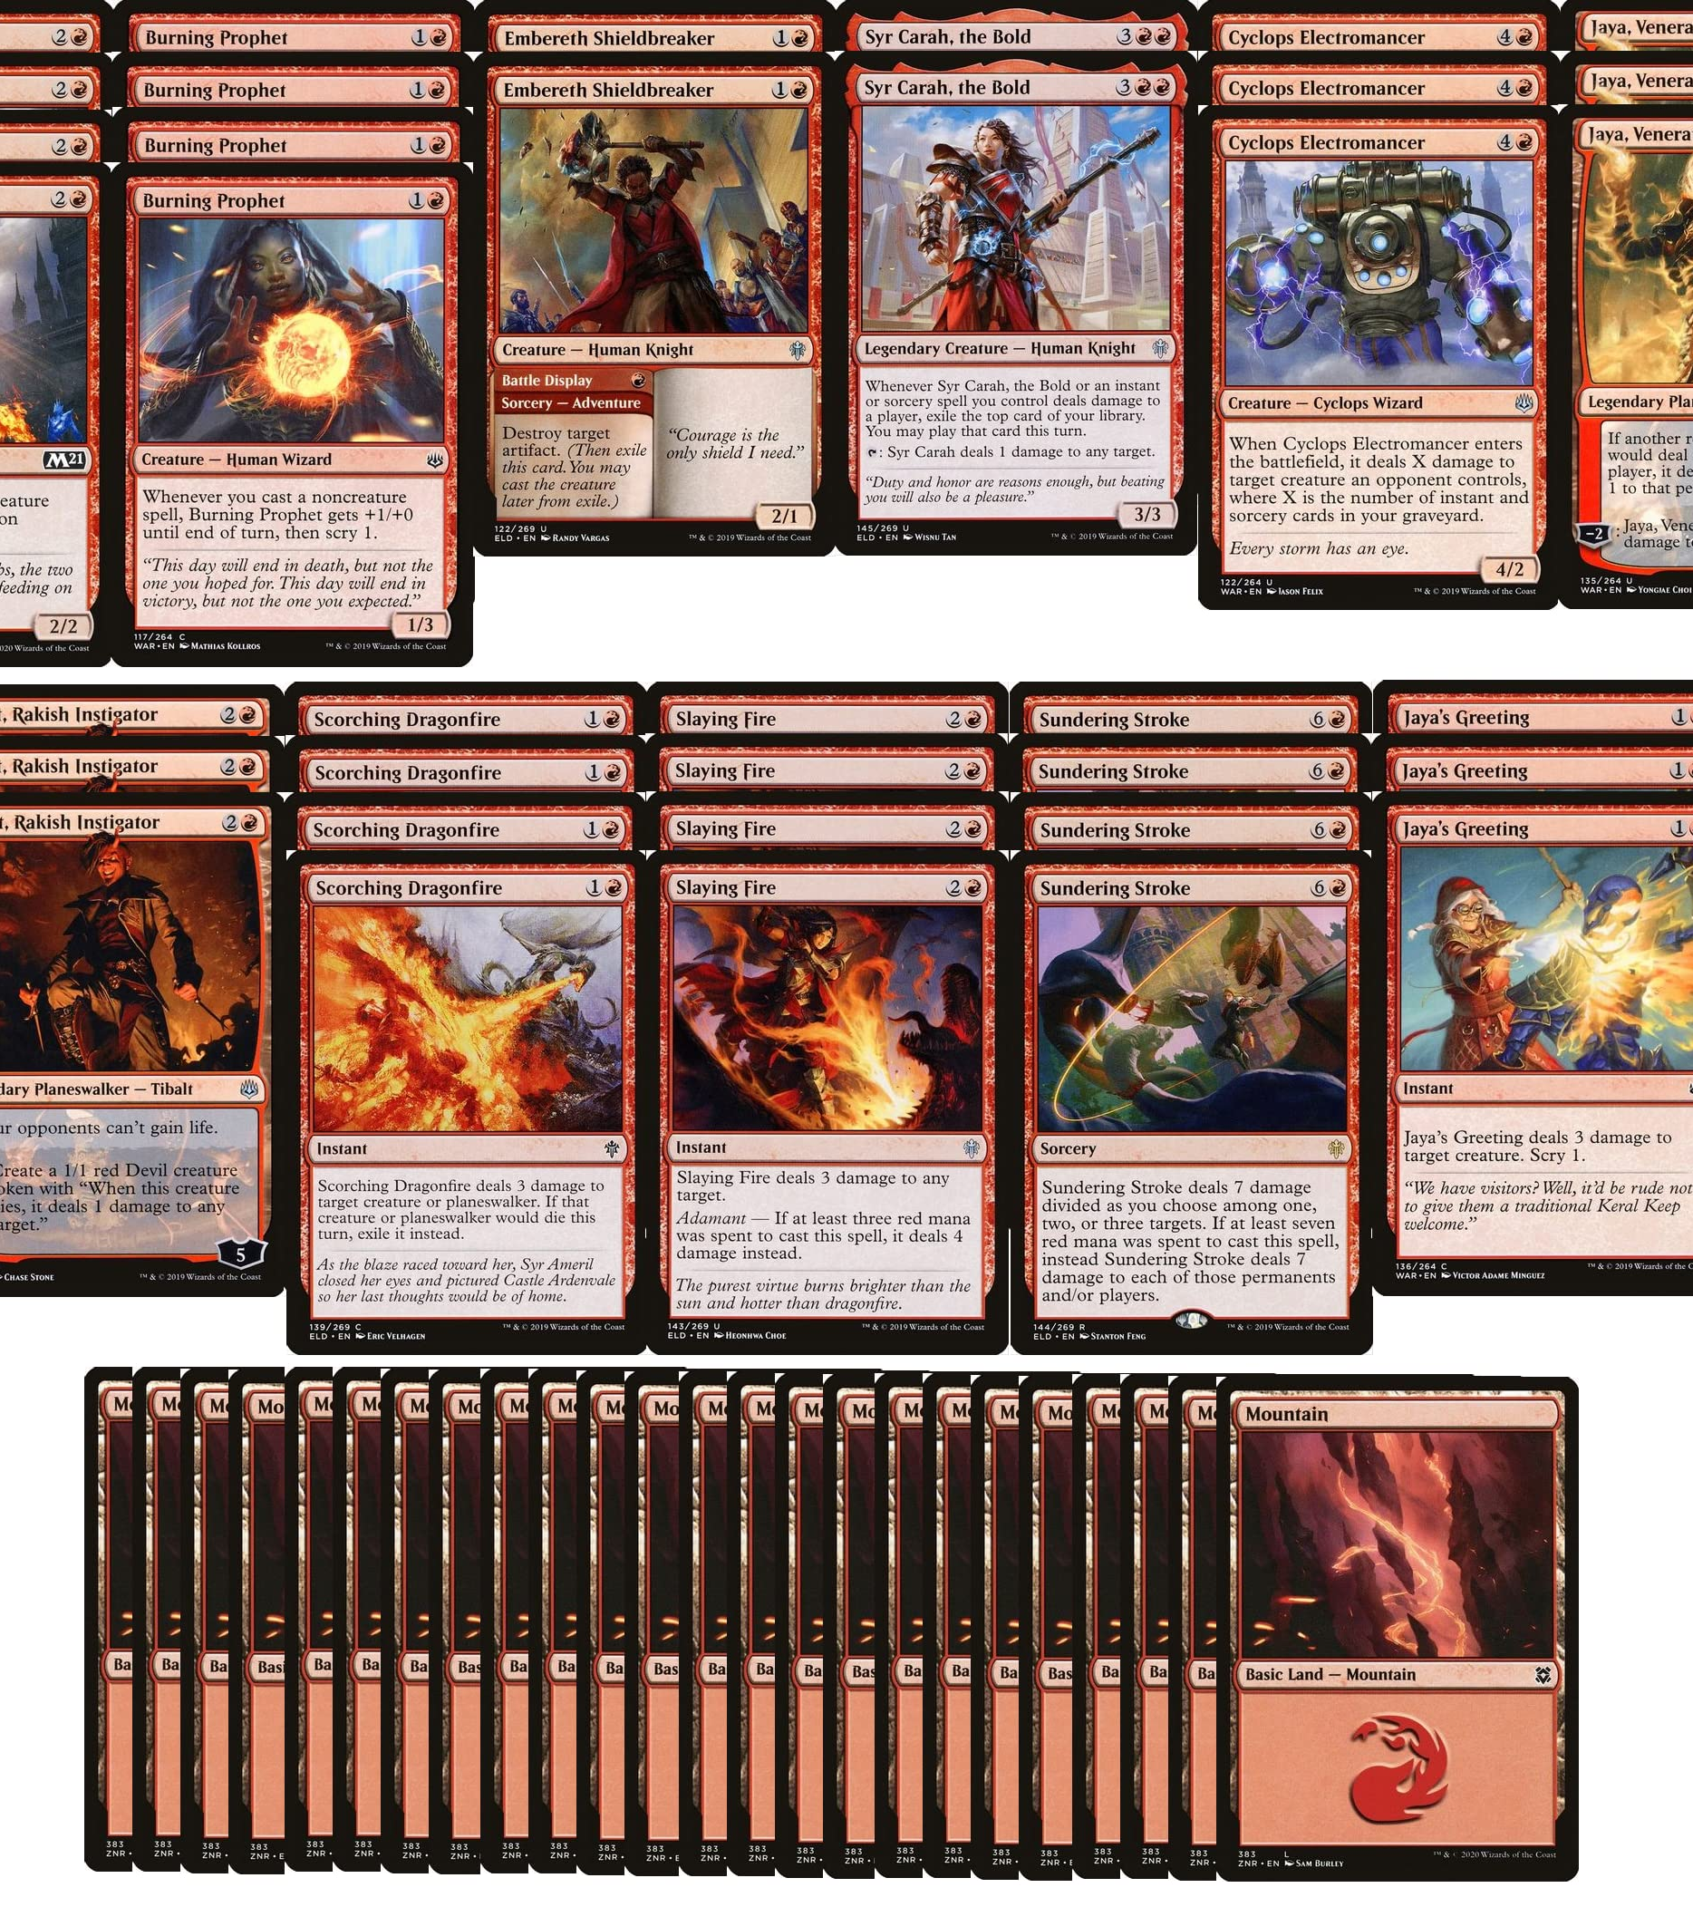
Goals
Predict color based on card text
Uncover storylines through flavor text topic modeling
Identify the positivity and negativity within each color
Notes:
So the goal for this analysis was to see if a supervised learning model could be created that would predict the color a card should be assigned based on the card’s text alone. Such a model could be used as a game development tool that would serve to help developers be more confident in making cards featuring creative ideas while seeing what color their abilities fit into best, identify opportunities for multi-color cards, and help them fit characters from different franchises, as is being done with their new multiverse releases, into the existing five color scheme.
Additionally, topic modeling was used on the flavor text of the cards to identify what parts of the Magic universe relate to what colors and identify storylines that affect each color. The flavor text is descriptive text that gives the backstory on the character featured on the card.
Lastly, a sentiment analysis was used to identify how positive or negative the characters within each color are, on average.

Slide 6
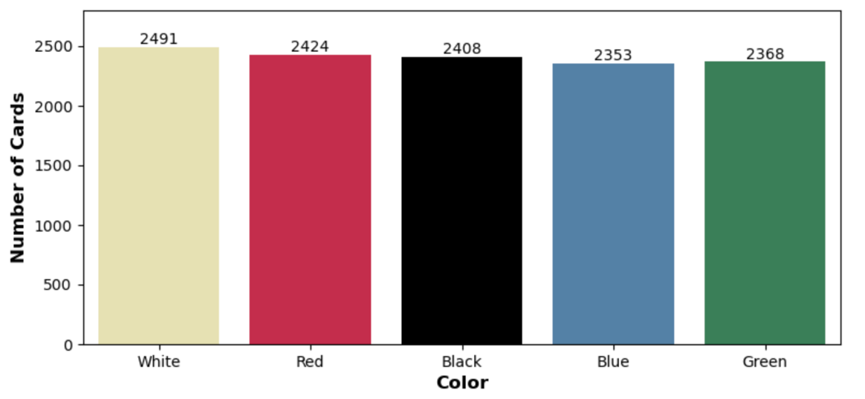
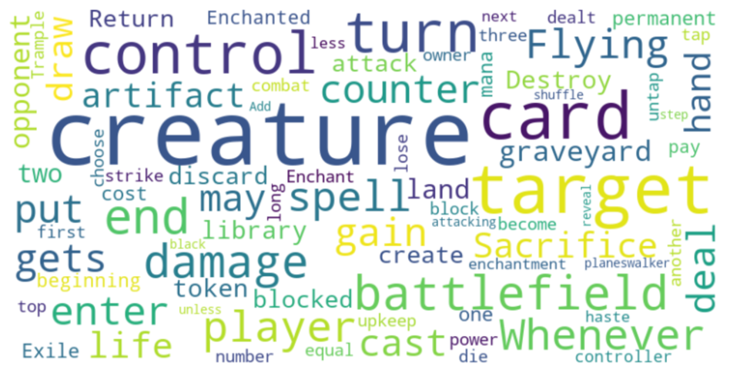
The Data
Collected from Scryfall API
Approx. 12,000 cards
Even distribution among colors
Identified main tuning opportunity
MTG stop words
Notes:
The data used in this analysis consisted of about 12,000 cards and was gathered from the Scryfall API. Visualizing the data showed an opportunity to tune the models by excluding certain word features. Words that are present on the cards very frequently throughout all the colors, such as creature, card, target, battlefield, turn, and more were selected as stop words. Varying the number of stop words excluded was one of the main ways that different models were made.

Slide 7
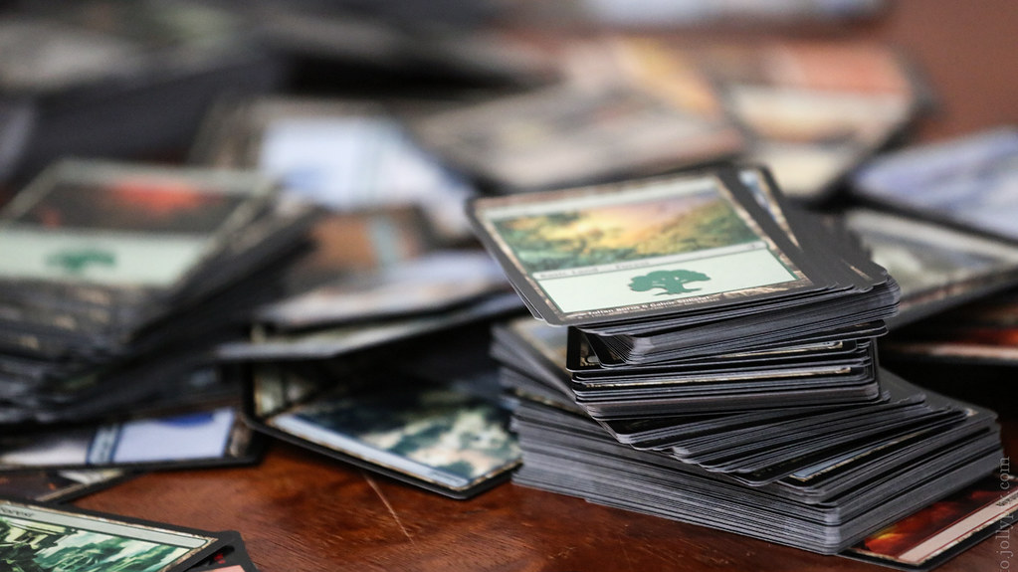
Models and Methods
Classification Models
Naïve Bayes
Decision Trees
Support Vector Machines
Topic Modeling
Latent Dirichlet Allocation
VADER Sentiment Intensity Analyzer
Notes:
For the classification model experiments, Naïve Bayes, Decision Trees, and SVM models were employed. The topic modeling used Latent Dirichlet Allocation, while the sentiment analysis used the VADER pre-trained sentiment intensity analyzer, since there are no sentiment labels already available for this data.

Slide 8
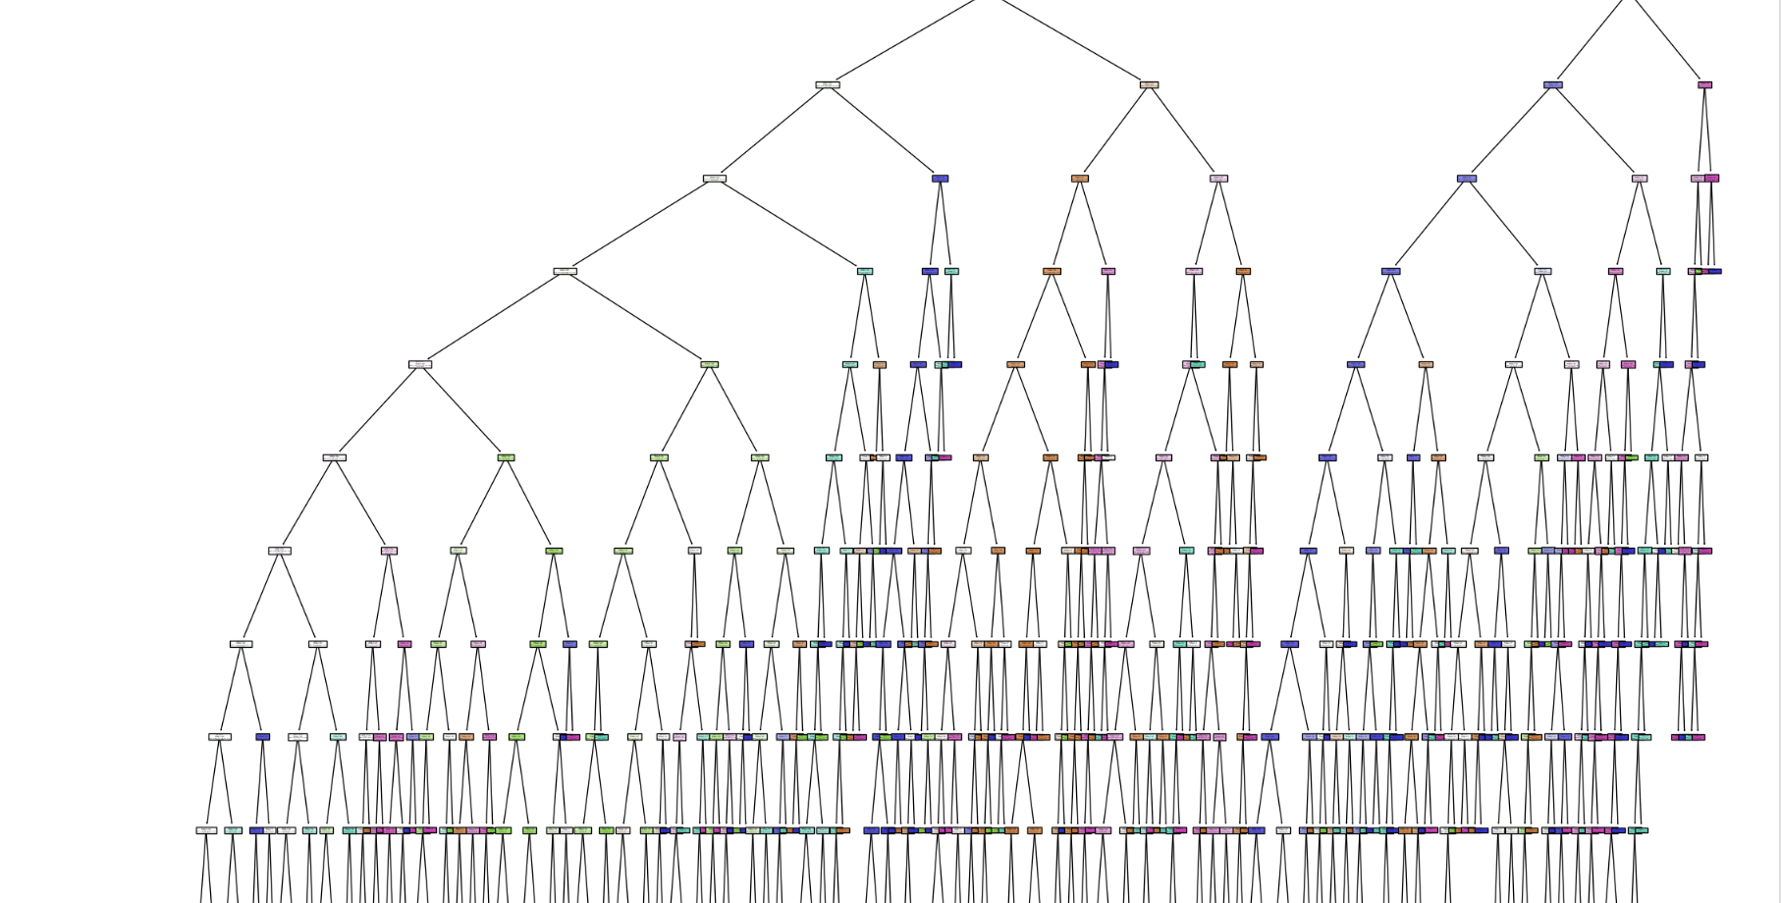
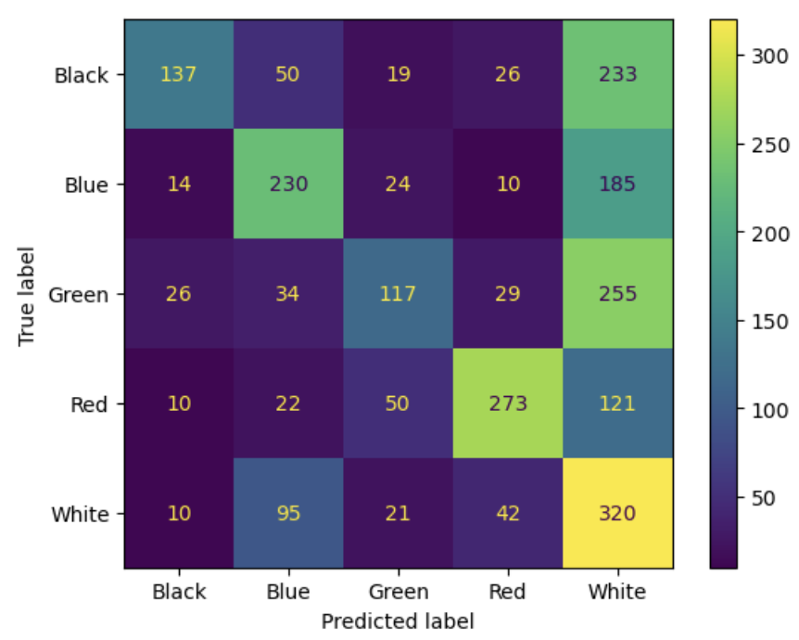
Not all models were successful
Decision Trees performed very poorly
Tuning did not improve results
Too many classes to predict
Trees too large and uninterpretable
Notes:
We’ll start with the result of the worst model type for this task. The decision trees performed very poorly with accuracies around 40%. With 5 target classes for the prediction, there was simply too much for the tree to decide between without becoming enormous and uninterpretable. The tree at the top right of the slide has a depth of 12 and is completely unreadable. These types of results led to further experiments with this model type being discontinued.

Slide 9
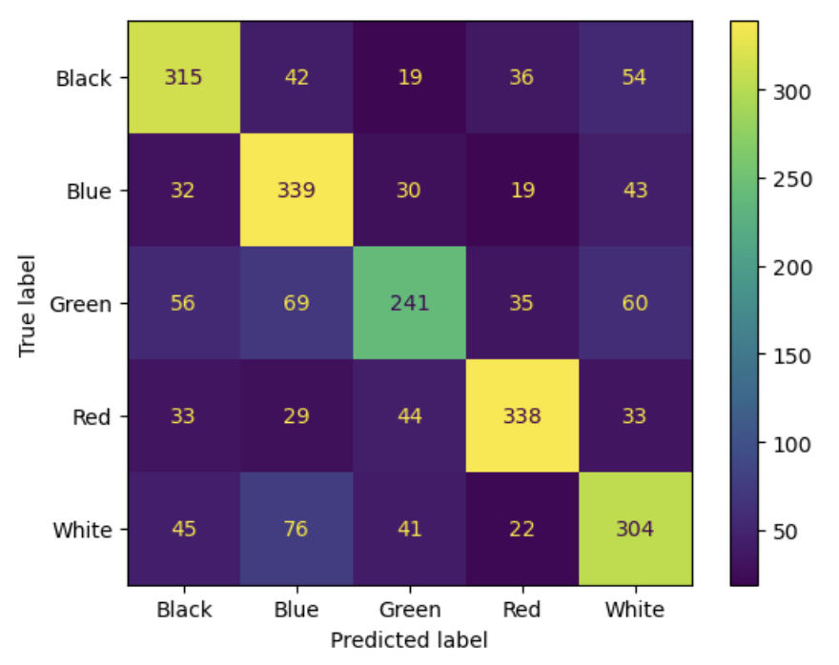
Support Vector machines: The best performing model
All SVM outperformed other model types
Consistent accuracy across classes
RBF kernel was most successful
Best performing model
65% overall accuracy
RBF kernel, binary CV, 350 unigram word features, MTG stop words removed
Notes:
The best performing models, however, were the SVM models. You can immediately see the difference in accuracy with this confusion matrix. The model has good accuracy across all the colors, although the green color always seemed to be more difficult to predict than the others. This result is from the RBF kernel SVM using 350 binary CountVectorizer word features with those additional Magic stop words removed. Removing all those stop words always resulted in better models than when less stop words were removed. With 65% overall accuracy, I felt that this model did a pretty good job overall. Taking into account that there are overlaps between the colors as an intended part of the game design, that there are five classes, and that this model is low-stakes in its application, this model performs quite well.

Slide 10



Topic modeling with lda
Topic 1: Crusaders
world faith sword like shield little let soldiers
come truth
Topic 2: Weatherlight Saga
place gerrard strike weatherlight righteous cause
right free walk shields
Topic 3: Religious Symbolism
hope new soul best night don angel light just single
Topic 8: Storm Magic
master good storm future run change living today
wind hand
Topic 9: Wizards
wizard secrets let new just lost spell won free
ertai
Topic 10: Weatherlight Saga
things day war moment hide weatherlight dream face secret past
Each color has unique storylines
Major storylines shared across colors
Some storylines last for many years
Consistent and careful world-building
Topic 8: Undead
think pain evil form feed death braids army dead live
Topic 9: Necromancy
mind fear cabal death bones necromancer new god
like just
Topic 10: Macabre
death life dead living kill time fall darkness left night
Notes:
From the topic modeling analysis, it was found that each color has unique characters and storylines that often live in separate planes (Magic’s version of continents or worlds). For example, the white cards are based around a theocratic society with leaders acting as crusaders and the blue cards are based on wizards experimenting with new types of power and knowledge. The different colors often come into conflict with one another and when they do, giant storylines spanning multiple years of card releases are created. These stories such up in multiple colors like is the case of the topic, Weatherlight Saga.
These results show that careful world-building and player immersion is a core tenant of the Magic game design. By identifying the main storylines of the past, developers can connect these events to new adventures in a consistent manner.

Slide 11
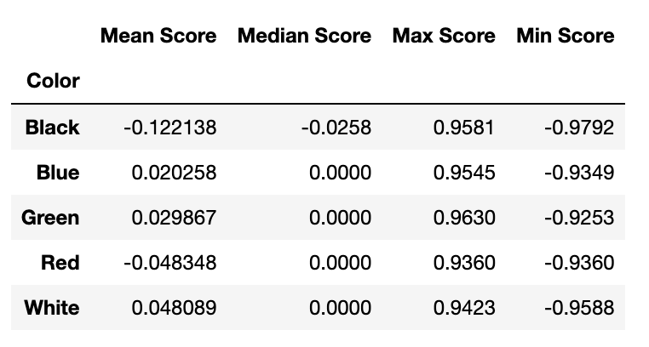
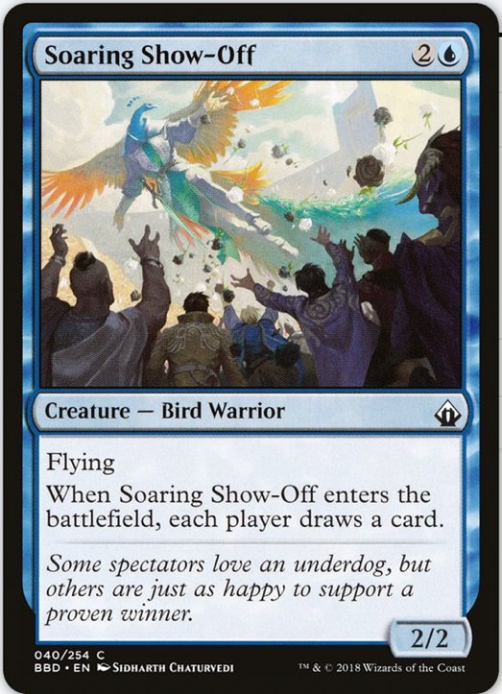
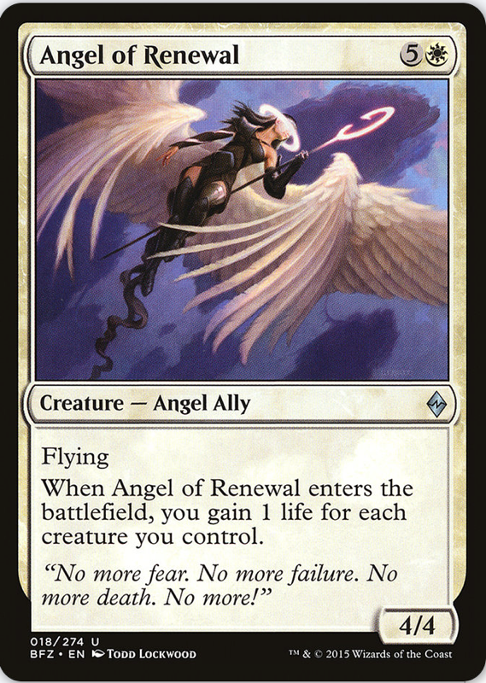
Sentiment analysis with vader
All colors are close to neutral
Very positive and negative cards in every color
No “bad” or “good” color
Realistic
Appeals to all players
Challenges
Word-by-word basis
Sometimes misses context or negation
Notes:
The VADER sentiment analysis returns scores of -1 to 1, where -1 is the most negative and 1 is the most positive. Scores between negative 0.05 and 0.05 are considered neutral. This analysis showed that all the colors are or are close to neutral on average, while each having very positive and very negative individual cards.
By having no good or bad colors, every color can appeal in some way to every player. Color would not be favored because someone doesn’t want to play as the “bad guys” for example. It also reflects the “realistic” fantasy world the game developers have created where there are good and bad events in every society.
This analysis does have its shortcomings, however. This model assigns scored based on a word-by-word evaluation so sometimes negation or context is missed. Looking at the right card, Angel of Renewal, it states there will be ‘no more fear’. We understand to read this as a good thing, but the model scores it negatively because of the presence of the words “no” and “fear” considered individually.

Slide 12
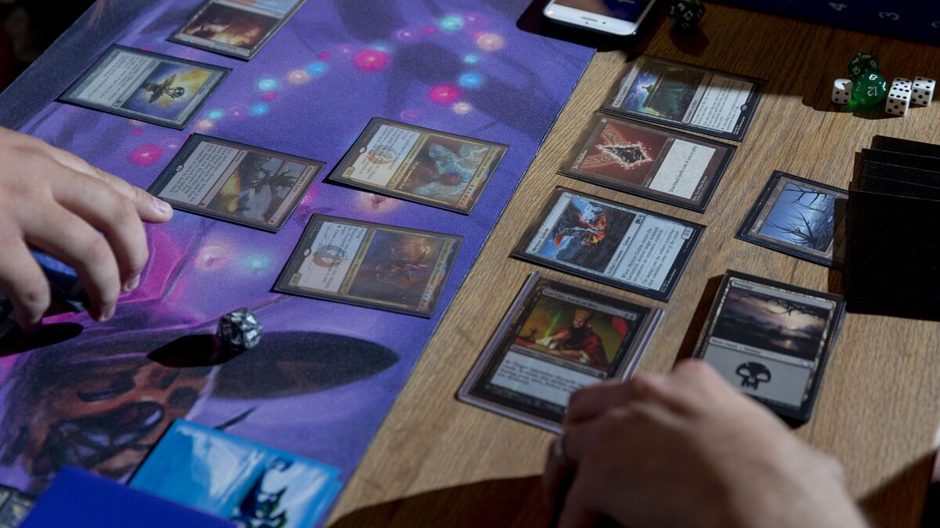
Conclusions
Colors can be predicted with card text
Five-class classification is difficult
SVM models are best suited
Flavor text storylines must match the color
Sentiments are balanced
Notes:
Overall, this analysis showed that while performing a five class classification is difficult that it can be done with the colors of Magic cards using just their text by using SVM models.
Flavor texts should continue to be written to match the color of card to ensure the Magic world stays consistent and realistic.
Each color also has a balanced sentiment, which makes every color approachable from a design standpoint to a wide range of players.

Slide 13
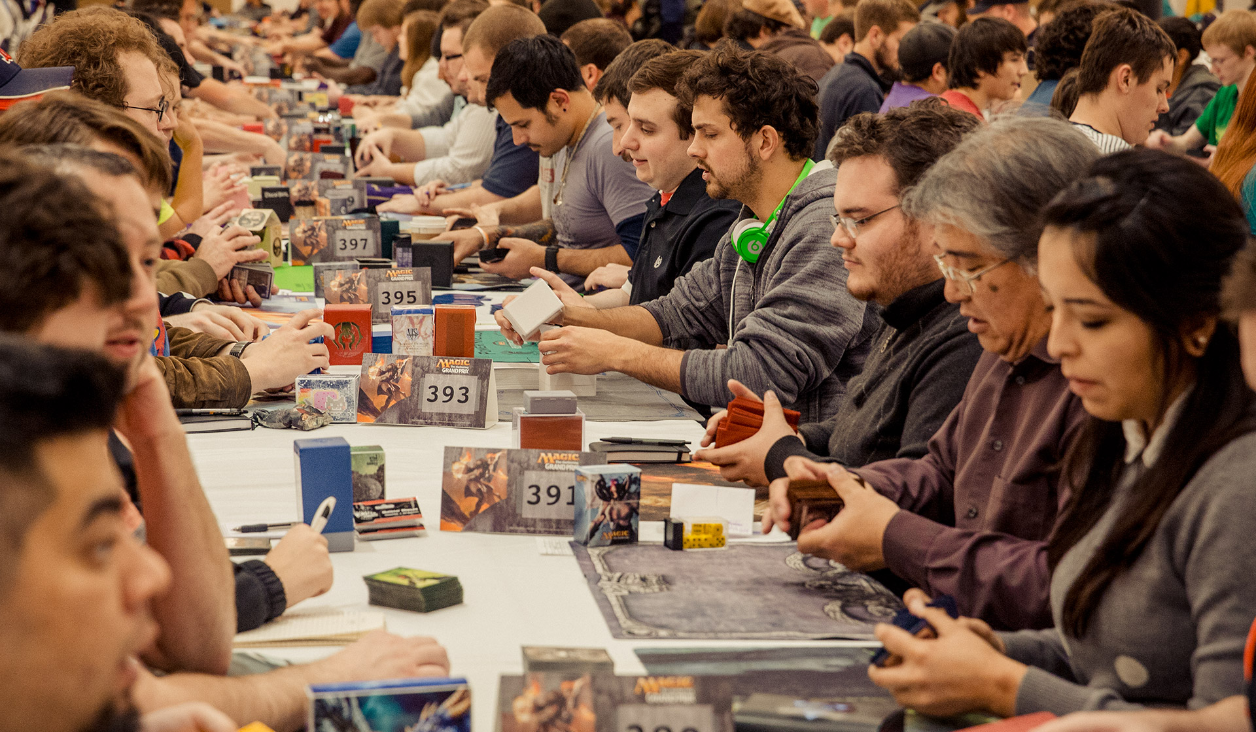
Next steps
Continue experimentation with word removal
“Head-to-head” models
Test model using next released cards
Multiverse expansions
Detect eras of MTG
How have stories changed over time?
Notes:
Continuing this analysis, it would be interested to run more experiments where different words are removed. Since this made the models more accurate, with a lot more time, a very optimized list of stop words could be created that might push the models into the 70% accuracy range or higher.
Making head to head models that do a two class classification between each of the two colors would also be interested. These could be used to “break the tie” in situations where a game developer thinks a card should be one color, but the main multi-class model predicts it differently.
Testing the model using unreleased cards as they are in development, such as with the upcoming multiverse expansions, would be very interesting. Here we could see if the model is able to actually do the job it was intended for or if there would be a big difference in accuracy.
Lastly, separating the cards into spans of several years and running new LDA topic modeling analyses could be used to identify different eras of history in the lore of Magic and show how stories have evolved over the last 30 years.

Slide 14
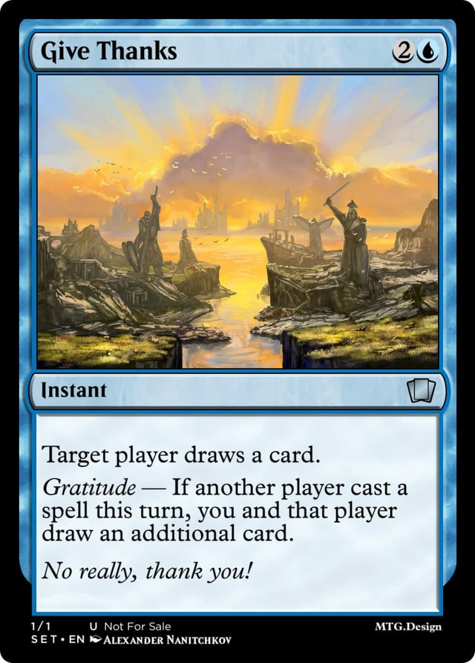
Any Questions?
Notes:
Thank you and I’ll be happy to answer any questions now.

